Slide 1
Project 4:
West Nile Virus Prediction
Disease & Treatment Agency
Chan Haosheng Timothy
Kho Guan Guo
Soh Sze Ron
Societal Cures in Epidemiology & New Creative Engineering

Slide 2
Table of contents
Background & Problem Statement
01
02
Data Cleaning
03
EDA
04
Modelling
05
Cost-Benefit Analysis
06
Conclusion & Recommendations

Slide 3
Background
In 2002, the first human cases of West Nile virus were reported in Chicago.
West Nile virus, is typically spread by mosquitoes.
Cost of treatment for severe symptoms developed from WNV can be staggeringly high.
Preventative measures like spraying of pesticides, can also be costly and potentially harmful to the environment.
It is thus essential to manage the spread of WNV efficiently and effectively.

Slide 4
Problem Statement
Team of data scientists at DTA
Understand key features for making accurate predictions
Predict areas where WNV mosquitoes can be detected
Optimise pesticide spraying effort
Formulate plan to deploy pesticides throughout the city

Slide 5
Data Cleaning
Missing data: Imputing weather data by deriving values from available data.
Duplicates: Number of mosquitos, dedupe < 50 and aggregate remaining.
Duplicates: Spray, remove
Columns: Similar categories/features not useful dropped

Slide 6
EDA
Correlation
Periods
Further investigation of periods (Average Monthly Temperature by Year)
Species
Traps
Barplots of various features
Location

Slide 7
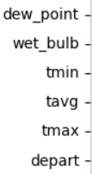
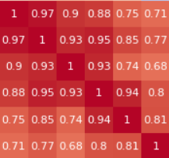
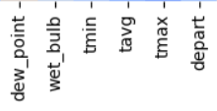
Correlation
Heatmap: Spearman Correlation*
Temperature related all highly correlated to each other. To only choose one of them as a feature.
High linear correlation between temperature features.
* Refer to Notebook for full visuals

Slide 8
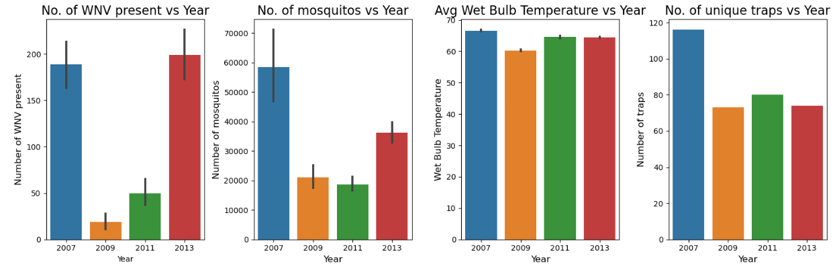
Periods
Mosquitoes are most active at 80°F, become lethargic at 60°F, and cannot function below 50°F.**
Wetbulb temperature was highest in 2007, but relatively high as well in 2011 and 2013.
Wetbulb temperature was lowest in 2009 which corresponds to the lowest WNV presence as well.
**Source: https://www.beyondpesticides.org/resources/mosquitos-and-insect-borne-diseases/documents/the-truth-about-mosquitoes,-pesticides-and-west-nile-virus

Slide 9
Periods
Higher WNV present in 2007 and 2013.
Same is true for number of mosquitos.

Slide 10
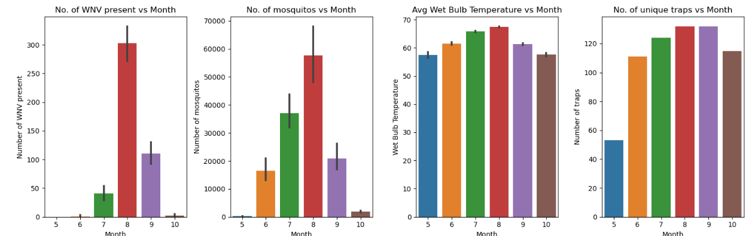
Periods
Number of mosquitoes and WNV cases peak in Aug (highest wet bulb temperature).

Slide 11
Periods
Most number of traps in Aug and Sep, corresponding to the peak WNV cases.

Slide 12
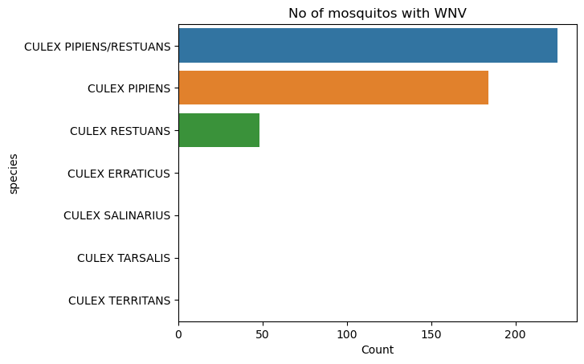
Species

Slide 13
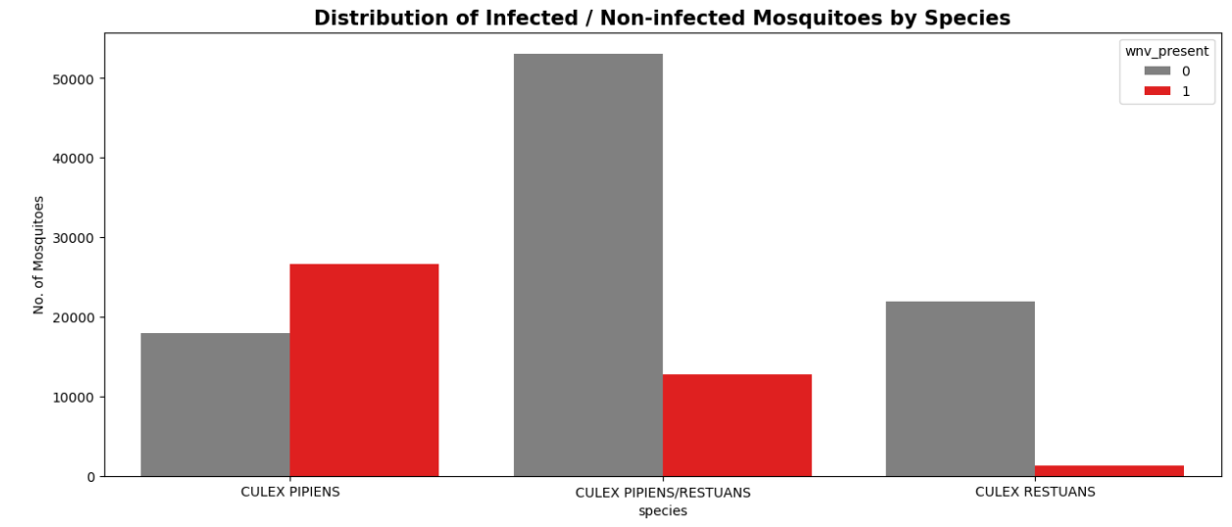
Species
The Culux Pipiens has a higher ratio of WNV present compared to Culux Restuans.

Slide 14
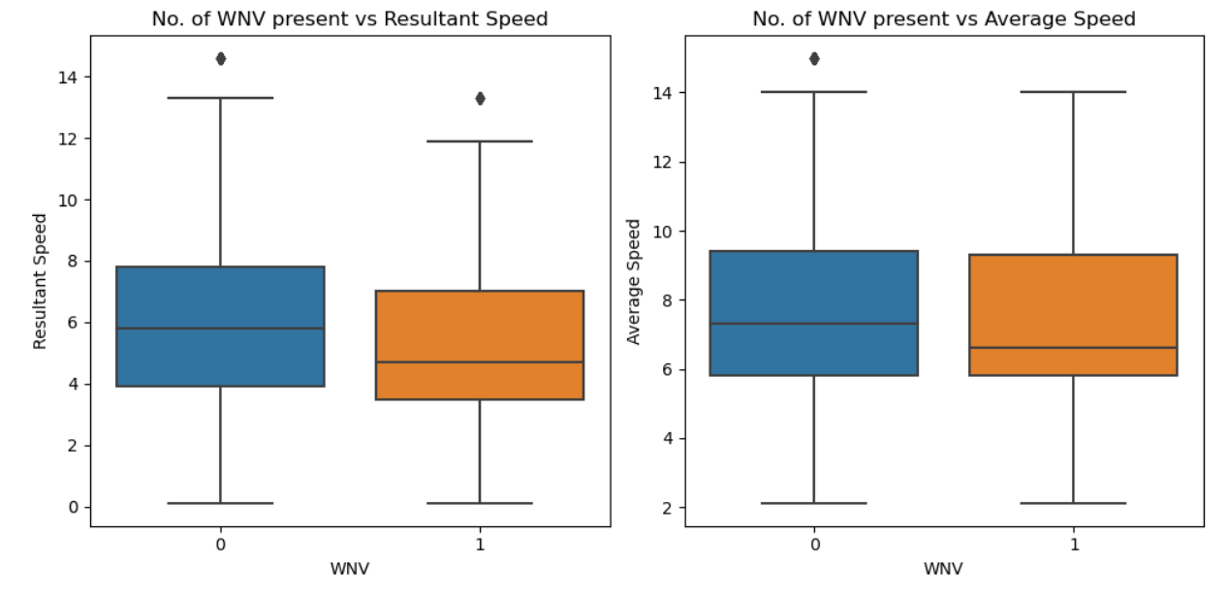
Wind Speed
Lower wind speed means more WNV. This is because mosquitoes are generally are not strong flyers.**
**Source:
https://www.orkin.com/pests/mosquitoes/when-are-mosquitoes-most-active

Slide 15
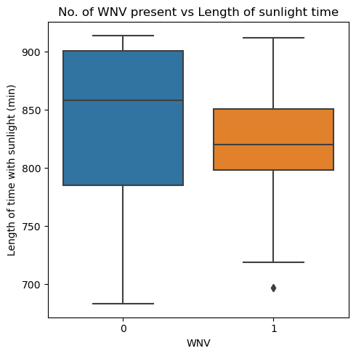
Daylight Time
Less sunlight duration means more cases. This could be because the Culux Pipiens is normally active at night.**
**Source:
https://www.mosquitomagnet.com/advice/mosquito-info/biting-insect-library/culex-pipiens-mosquito

Slide 16
Location
Areas near the airport and near water sources are likely to be better environments for mosquitoes to thrive. Locations with high number of cases vary from year to year.
Ohare Airport, Lake Camulet and Wolf Lake
Density of WNV found by location shows higher concentration in the general North West and South East regions.

Slide 17
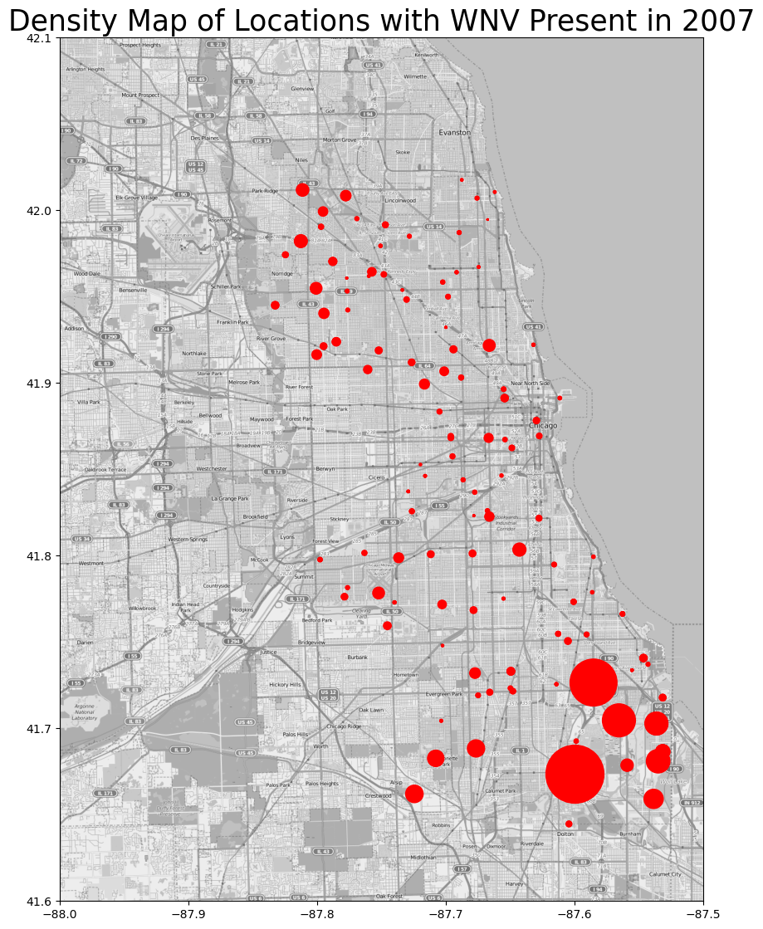
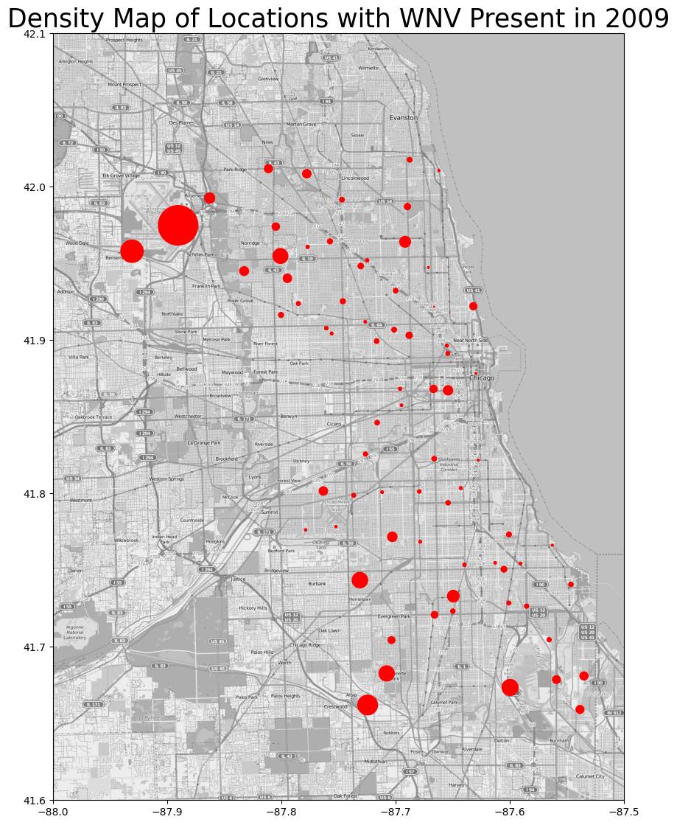
Location

Slide 18
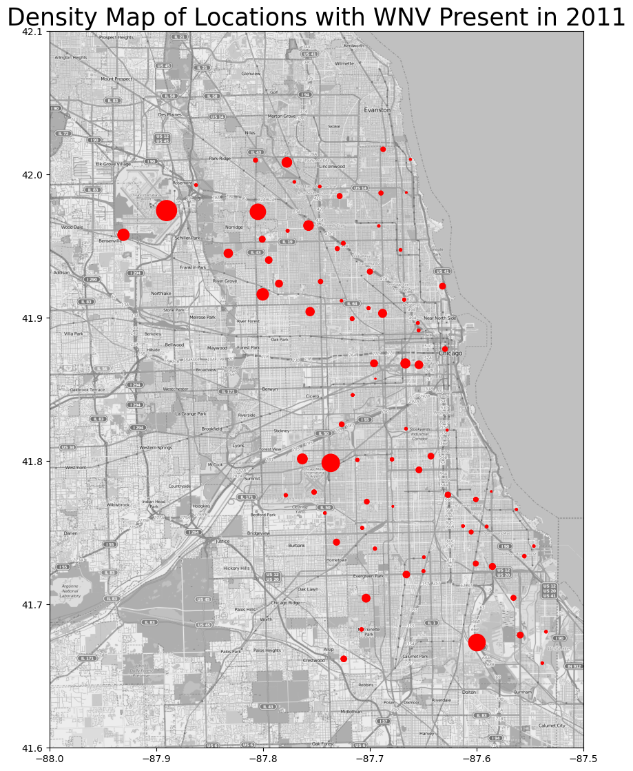
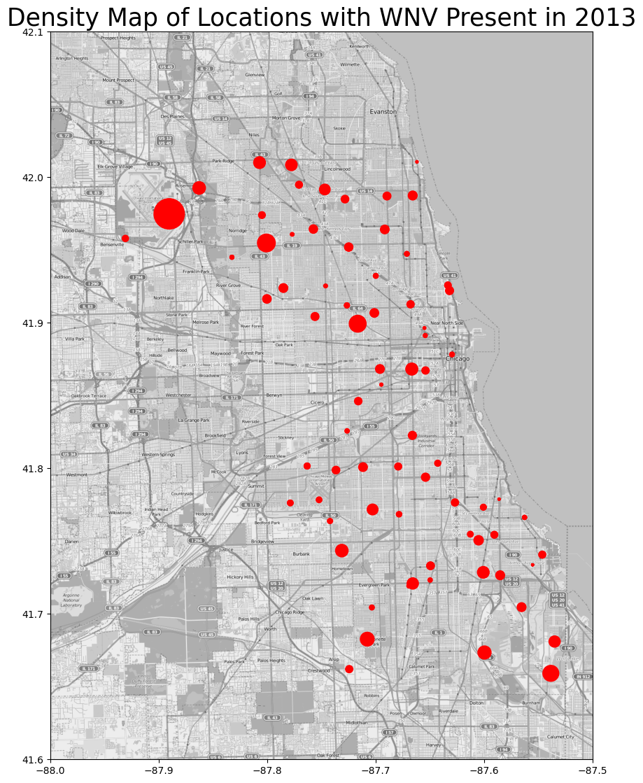
Location

Slide 19
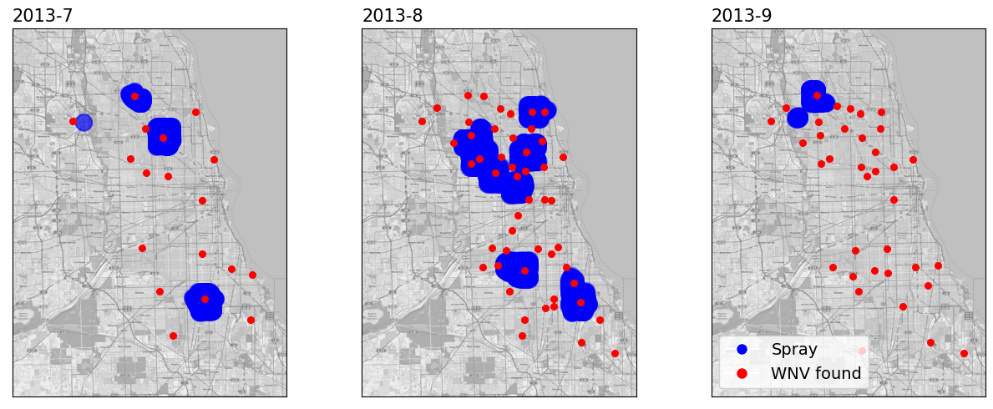
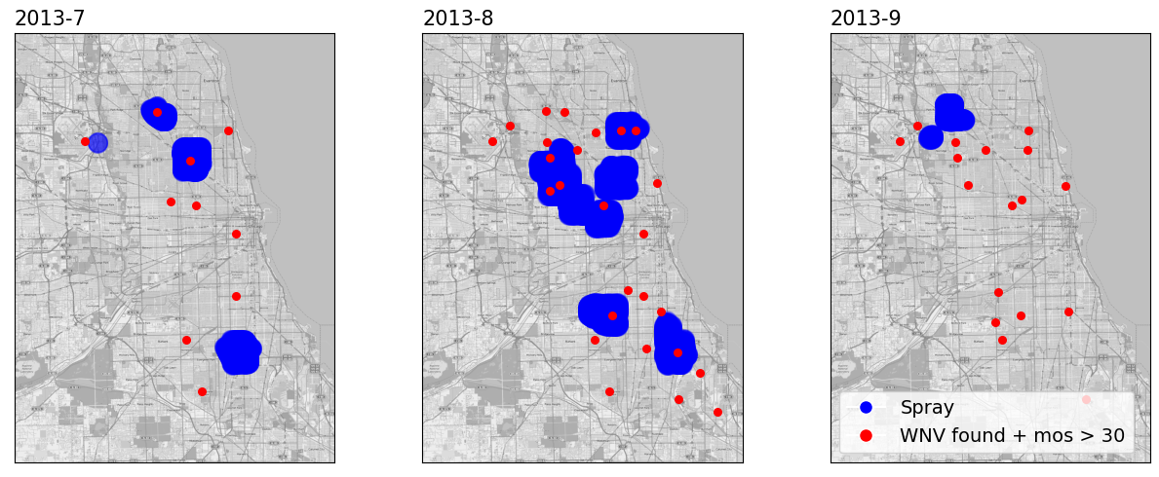
Spray
Spray + WNV present
Spray + WNV present and > 30 Mosquitos
We noted that number of cases (the red spots) decreased in Sep.
Number of mosquitoes decreased naturally after the peak in Aug.

Slide 20
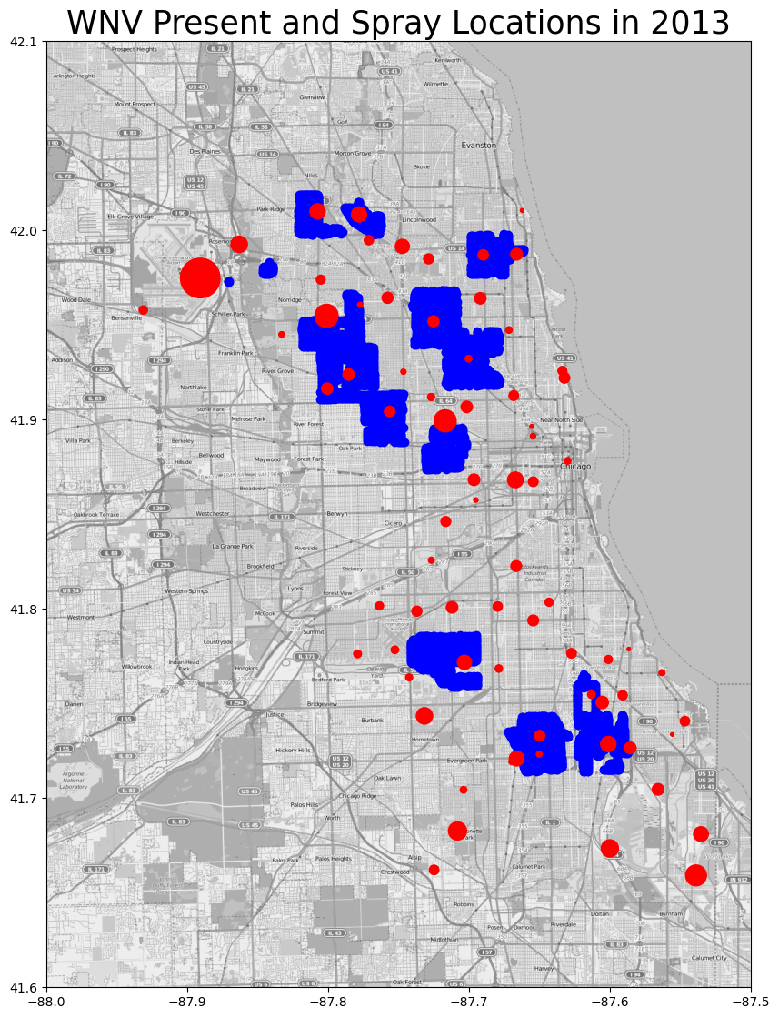
Spray
Most of the concentration seems to be in 2 broad range hot spots in the North West and the South East.
The spray areas do not necessarily cover all areas with WNV presence.

Slide 21
Modelling

Slide 22
Evaluation Metrics
Use Area under the curve (AUC)
better at handling class imbalance
captures the trade-off between the TPR and FPR
Precision-Recall Trade-off:
Recall: over-spraying areas with low number of WNV present
Precision: under-spraying areas with high number of WNV present
Recall more important: target > 0.70 recall score

Slide 23
Feature selection
Daylight duration
Week number
Wet bulb temperature
Species (culex pipiens, culex pipiens/restuans and culex restuans)
Resultant wind speed
Location (clustering of coordinates using DBscan)

Slide 24
Models
Model | Classifier | AUC (Val) | AUC (Kaggle) | Recall (Val)
1 | Logistic Regression | 0.791 | 0.656 | 0.781
2 | Logistic Regression (less features) | 0.748 | 0.582 | 0.772
3 | Multinomial Naive Bayes | 0.708 | N/A | 0.737
4 | Random Forest | 0.838 | 0.609 | 0.702
5 | Random Forest (less features) | 0.822 | 0.680 | 0.693
6 | XGBoost | 0.844 | 0.579 | 0.544
7 | XGBoost (less features) | 0.832 | 0.600 | 0.693
8 | Random Forest (less features) & fine-tuned | 0.822 | 0.701 | 0.746

Slide 25
Confusion Matrix
1499 | 506
29 | 85
FP: Oversprayed
0
True
1
FN: Undersprayed
0
Predicted
1

Slide 26
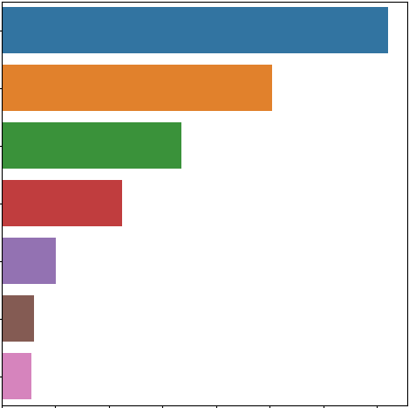
Feature Importance
Daylight time
Week number
Wet bulb temperature
Resultant wind speed
Species: Culex Restuans
Species: Culex Pipiens/Restuans
Species: Culex Pipiens

Slide 27
Possible model improvement
Validation design to avoid overfitting e.g.
train-test split by years
Train data: 2007, 2009, 2011, 2013
Test data: 2008, 2010, 2012, 2014
perform training and validation on different years

Slide 28
Cost-Benefit Analysis

Slide 29
Cost-Benefit Analysis
Costs
Benefits
Goal
Pesticides
Manpower
Savings in medical expenses
Savings in economic costs
Find the optimal balance between total costs and level of benefit achieved

Slide 30
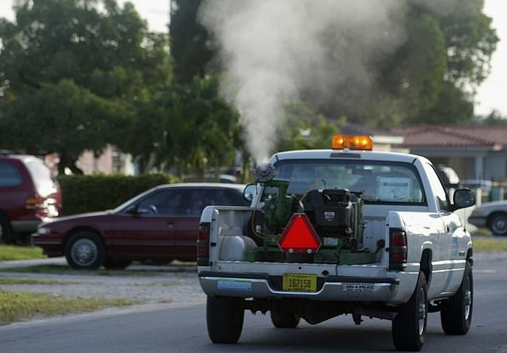
Costs
Spray data: 2011: 2x in 2 weeks,
2013: 8x in 8 weeks
Chicago Department of Public Health (CDPH) uses Zenivex E4 insecticide for spraying citywide
Applied at 1.5 fl oz / acre at 10mph
Assumptions: 50 trucks available, spray radius of 100sqft, labour cost @ $20/hr
68h to cover entire Chicago area

Slide 31
Benefits
Savings in medical costs
ASTMH: annual medical costs of WNV in U.S = $57M
Annual medical costs of WNV in Chicago (interpolated) = $1.83M
Savings in economic costs
NLM: productivity loss for those < 60 = $955 daily
> 60 = $625 daily
Symptoms last 3-6 days -> productivity loss per individual = $4000

Slide 32
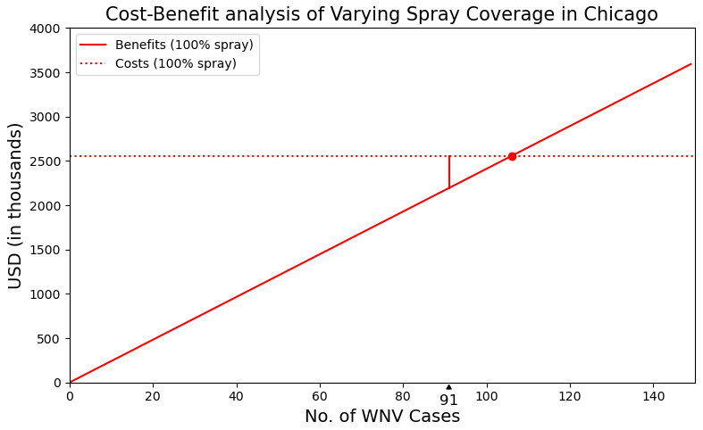
Base Scenario
According to CDC, average annual Chicago cases = 91
12 applications across 12 weeks (Jul - Sep)
100% Coverage
Costs of spray: $1.75M
Manpower costs: $810k
Total Costs: $2.56M*
Savings in medical expenses = $ 1.83M
Savings in economic costs = $364k
Total Benefits: $2.19M*
$370k loss
Net Loss: $370k*
* Based on average annual cases in Chicago (91)

Slide 33
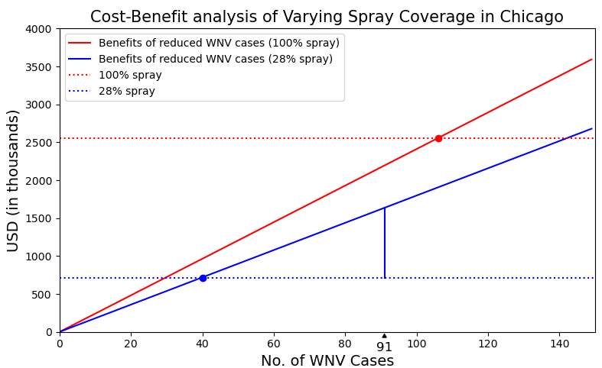
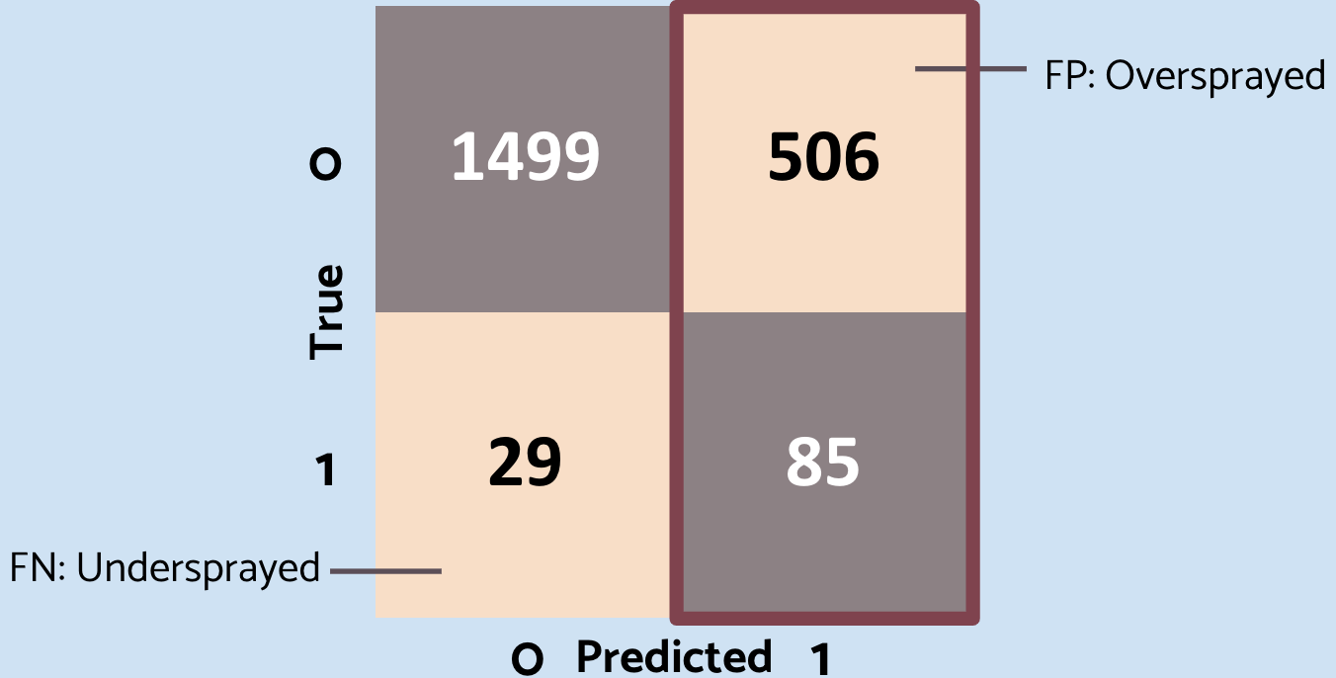
Scenario 1: Targeted Spray Coverage
% Spray Coverage in Chicago: 28% (based on Predicted / Total Score)
Total Costs: $713k*
Total Benefits: $1.64M*
Net Gain: $927k*
$927k gain
* Based on average annual cases in Chicago (91)

Slide 34
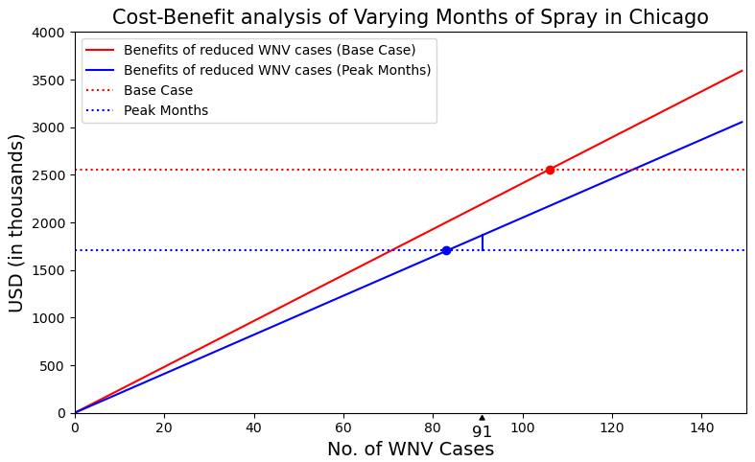
Scenario 2: Spray in Peak Months (Aug/Sep)
Based on 20-year historical average, the number of WNV cases in USA during WNV season are as follows:
July: 7,217
Aug: 21,791
Sep: 18,080
Spray in Aug/Sep as 85% cases
Total Costs: $1.71M*
Total Benefits: $1.87M*
Net Gain: $160k*
$160k gain
* Based on average annual cases in Chicago (91)

Slide 35
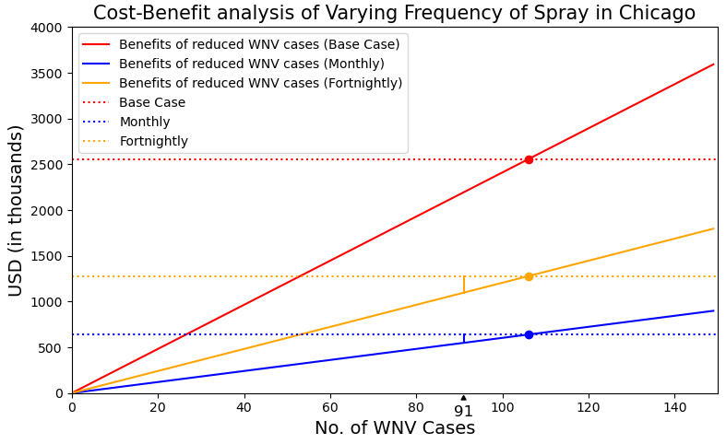
Scenario 3: Vary Frequency
(Monthly/Fortnightly)
Monthly basis
Total Costs: $640k*
Total Benefits: $549k*
Net Loss: $91k*
Fortnightly basis
Total Costs: $1.28M*
Total Benefits: $1.1M*
Net Loss: $180k*
$180k loss
$91k loss
* Based on average annual cases in Chicago (91)

Slide 36
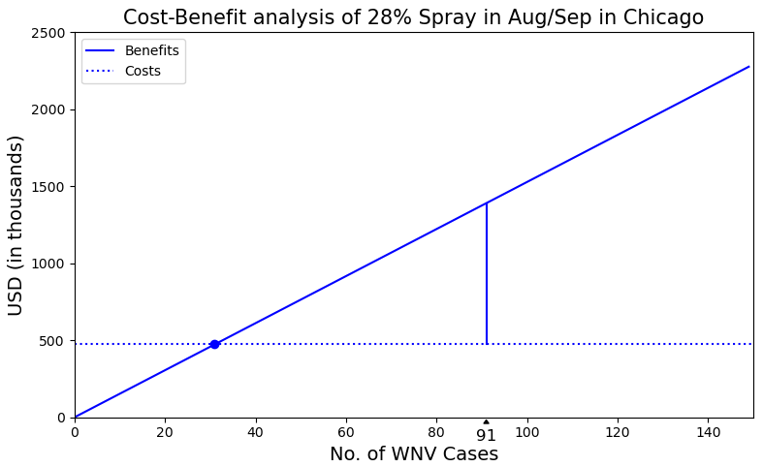
Hybrid approach - 28% Targeted Spray +
Peak Months (Aug/Sep)
Total Costs: $476k
Total Benefits: $1.39M
Net Gain: $914k
$914k gain
* Based on average annual cases in Chicago (91)

Slide 37
Results of analysis
 | Coverage | Total Costs* ($) | Total Benefits* ($) | Breakeven Cases | Net Gain / Loss* ($)
Base Scenario | 100% | 2.56M | 2.19M | 106 | -370k
28% Spray Coverage | 28% | 713k | 1.64M | 40 | 927k
Spray in Peak Months (Aug/Sep) | 100% | 1.71M | 1.87M | 83 | 160k
Monthly Basis | 100% | 640k | 549k | 106 | -91k
Fortnightly Basis | 100% | 1.28M | 1.1M | 106 | -180k
28% Coverage + Peak Months | 28% | 476k | 1.39M | 31 | 914k
* Based on average annual cases in Chicago (91)

Slide 38
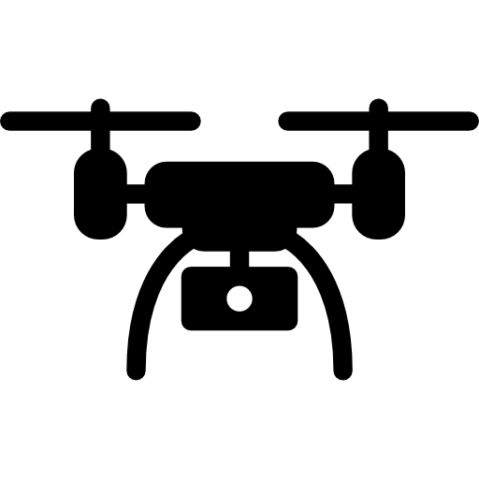
Recommendations
Subsidising costs of pesticide
Agricultural Drones
Lab-grown mosquitoes
Motivate people to take action
Cheaper
Greater accessibility
Wolbachia-carrying mosquitoes

Slide 39
Conclusion
Key factors that impact presence and spread of WNV:
Longer daylight hours
Period of the year
Higher temperatures
Spraying efforts should target high-risk areas during peak months
Targeted approach relies on having a good predictive model

Slide 40
Thank you

